Slide 1
Linear Regression Considerations
By Cheuk-Hang Tse

Slide 2
Table of Content
Linear Regression with Qualitative Predictor(s)
Interaction Term in Linear Regression
Remove High Leverage in the Data
Remove Outlier in the Data
Collinearity in the Data

Slide 3
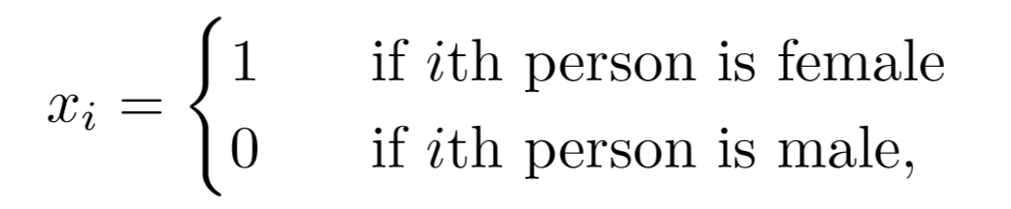
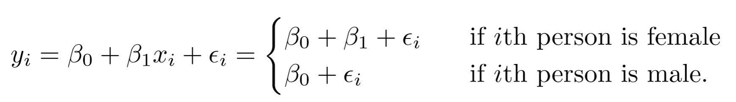
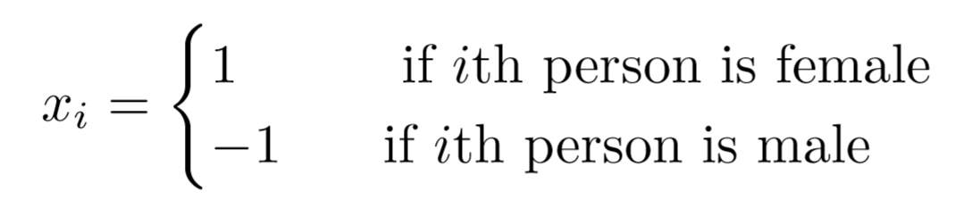
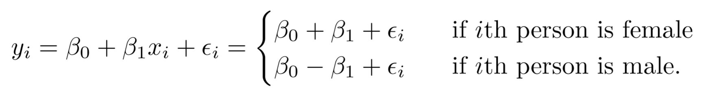
Linear regression with Qualitative Predictor(s)
Use dummy variable to identity levels of the qualitative predictor
Another coding scheme for dummy variable is:

Slide 4
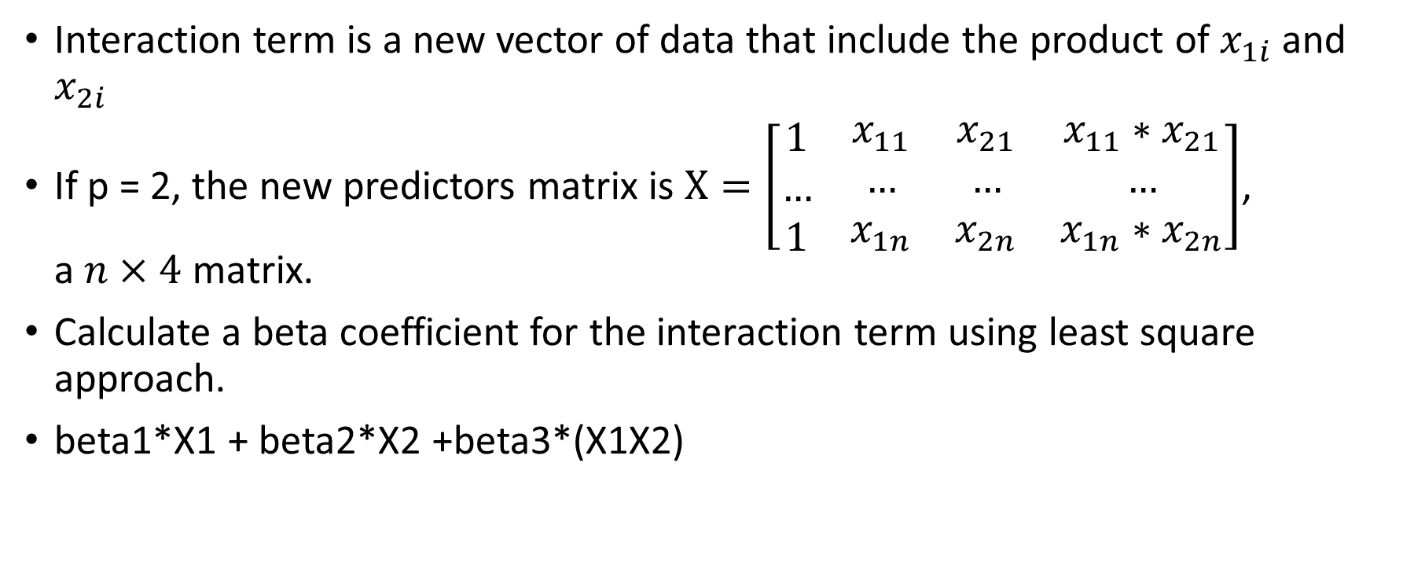
Interaction Term in Linear Regression
Interaction term is a new vector of data that include the product of $x_{1i}$ and $x_{2i}$
If p = 2, the new predictors matrix is $X=\left[\begin{matrix}1 \\ … \\ 1\end{matrix} \begin{matrix}x_{11} & x_{21} & x_{11}∗x_{21} \\ … & … & … \\ x_{1n} & x_{2n} & x_{1n}∗x_{2n}\end{matrix}\right]$, a $n×4$ matrix.
Calculate a beta coefficient for the interaction term using least square approach.
beta1*X1 + beta2*X2 +beta3*(X1X2)

Slide 5
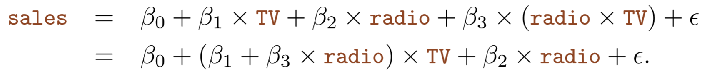
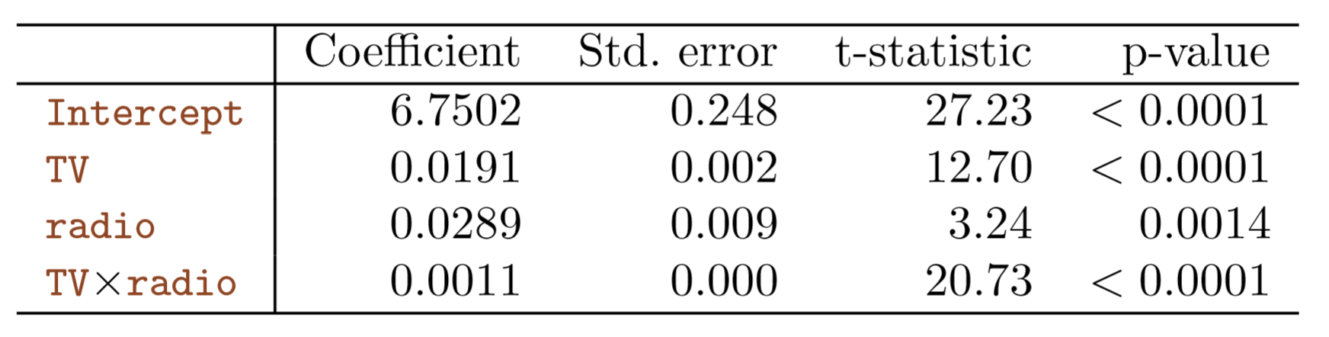

Example
In Advertising data, radio and TV show evidence of a synergy or interaction effect.
$R^{2}(with interaction term)=0.968$
$R^{2}(without interaction term)=0.868$

Slide 6
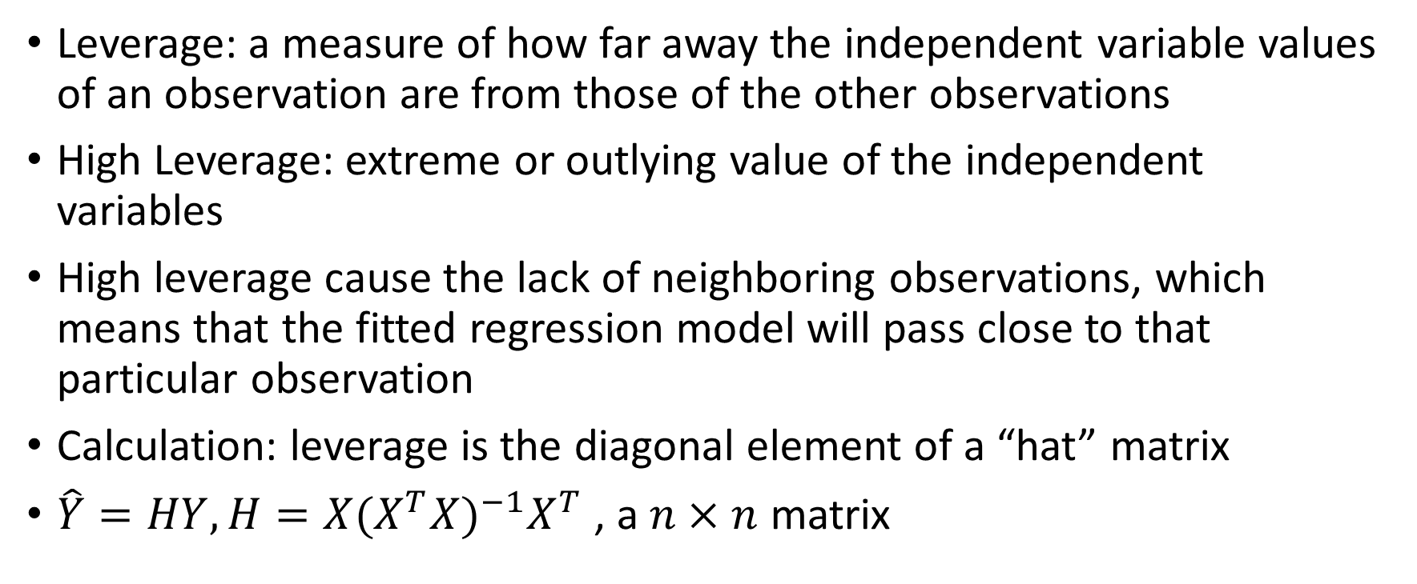
High leverage in the Data
Leverage: a measure of how far away the independent variable values of an observation are from those of the other observations
High Leverage: extreme or outlying value of the independent variables
High leverage cause the lack of neighboring observations, which means that the fitted regression model will pass close to that particular observation
Calculation: leverage is the diagonal element of a “hat” matrix
$\hat{Y}=HY, H=X{(X^{T}X)}^{−1}X^{T}$ , a $n×n$ matrix

Slide 7
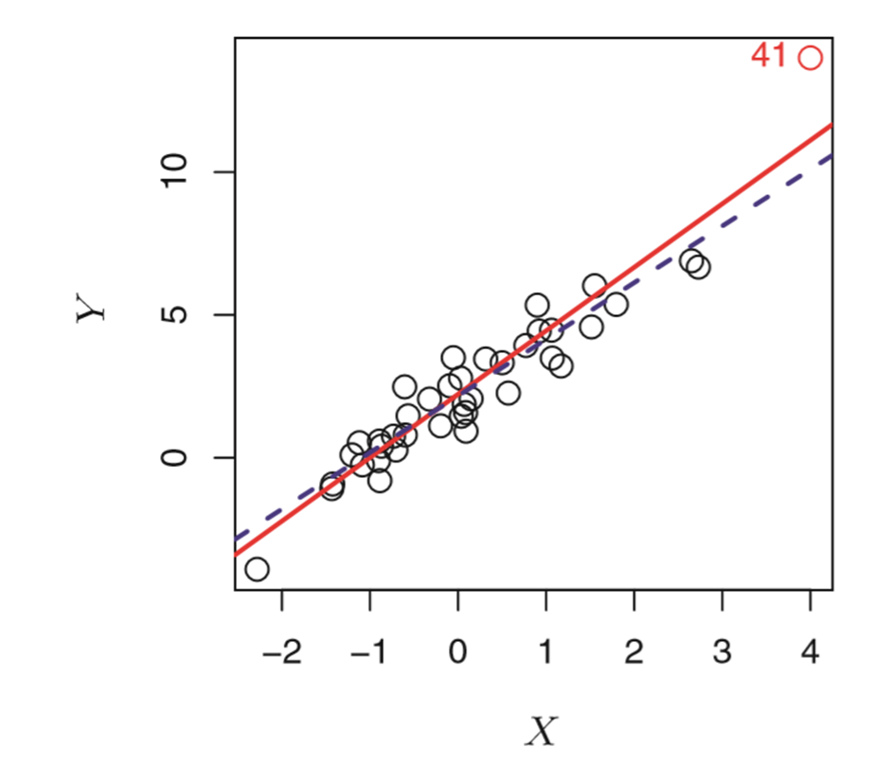

How to determine High Leverage
Determine if the leverage is high leverage by see if the leverage greatly, exceeds the average leverage for all the observation
About 3$(p+1)/n$.

Slide 8
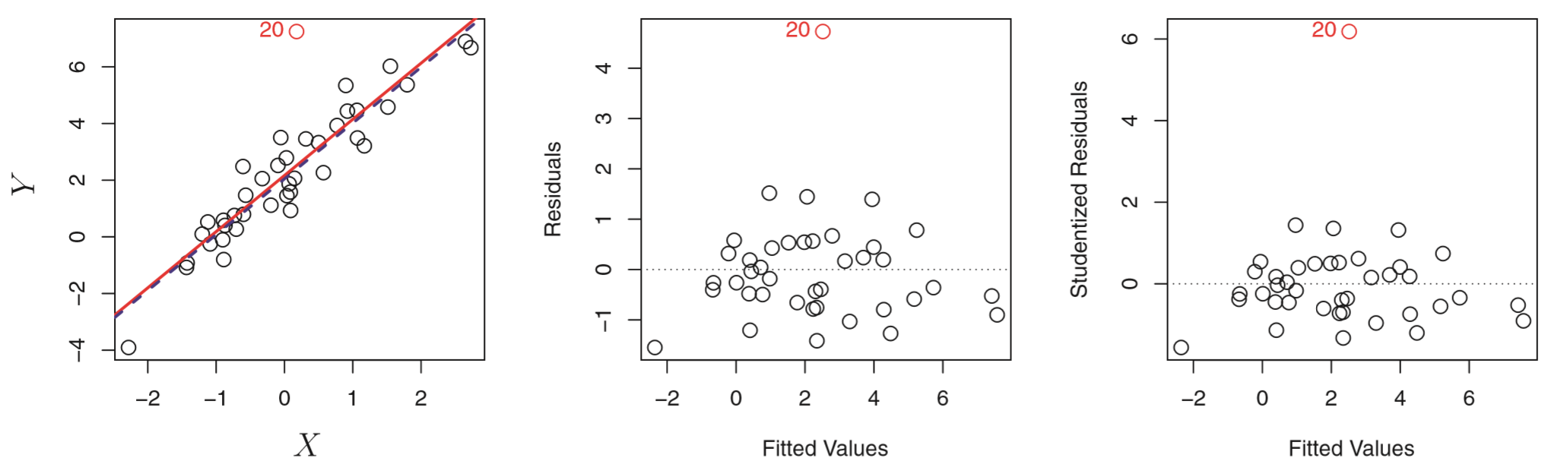

Outlier in the Data
Outlier: a point for which $y_{i}$ is far from the value predicted by the model.
Studentized residual: the quotient resulting from the division of a residual by an estimate of its standard deviation

Slide 9
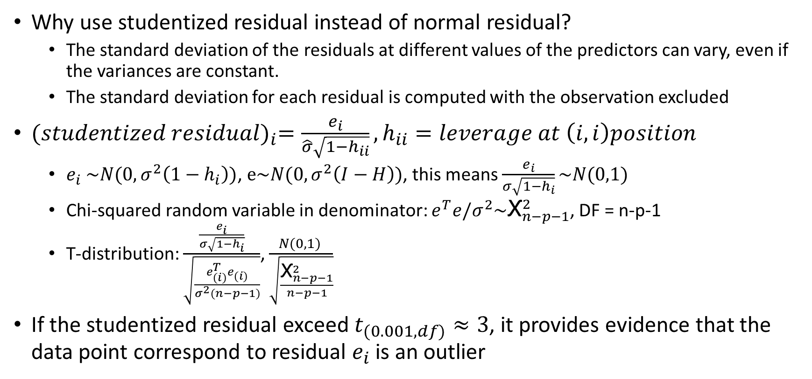
How to determine Outlier
Why use studentized residual instead of normal residual?
The standard deviation of the residuals at different values of the predictors can vary, even if the variances are constant.
The standard deviation for each residual is computed with the observation excluded
${(studentized residual)}_{i}=\frac{e_{i}}{\hat{σ}\sqrt{1−h_{ii}}},h_{ii}=leverage at \left(i,i\right)position$
$e_{i} \sim N(0,σ^{2}\left(1−h_{i}\right))$, $e\sim N(0,σ^{2}\left(I−H\right))$, this means $\frac{e_{i}}{σ\sqrt{1−h_{i}}}\sim N(0,1)$
Chi-squared random variable in denominator: $e^{T}e/σ^{2}\sim {\text{Ⲭ}}_{n−p−1}^{2}$, DF = n-p-1
T-distribution: $\frac{\frac{e_{i}}{σ\sqrt{1−h_{i}}}}{\sqrt{\frac{e_{(i)}^{T}e_{(i)}}{σ^{2}(n−p−1)}}}$, $\frac{N(0,1) }{\sqrt{\frac{{\text{Ⲭ}}_{n−p−1}^{2}}{n−p−1}}}$
If the studentized residual exceed $t_{(0.001, df)}≈3$, it provides evidence that the data point correspond to residual $e_{i}$ is an outlier
Notes:
Ref: Studentized Residual: https://www.jmp.com/en_us/statistics-knowledge-portal/what-is-multiple-regression/mlr-residual-analysis-and-outliers.html#:~:text=The%20standard%20deviation%20for%20each,assessing%20the%20equal%20variance%20assumption.
T-distribution: https://stats.stackexchange.com/questions/396190/do-studentized-residuals-follow-t-distribution

Slide 10
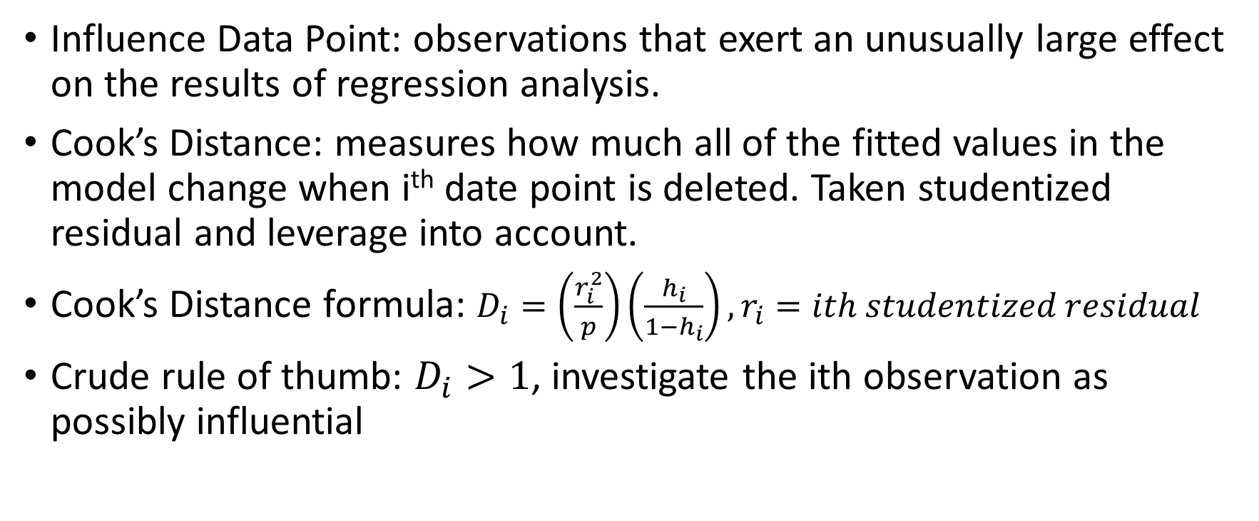
Influence Data Point
Influence Data Point: observations that exert an unusually large effect on the results of regression analysis.
Cook’s Distance: measures how much all of the fitted values in the model change when i^{th} date point is deleted. Taken studentized residual and leverage into account.
Cook’s Distance formula: $D_{i}=\left(\frac{r_{i}^{2}}{p}\right)\left(\frac{h_{i}}{1−h_{i}}\right), r_{i}=ith studentized residual$
Crude rule of thumb: $D_{i}>1$, investigate the ith observation as possibly influential
Notes:
Reference:
Formula: https://www.stat.colostate.edu/~riczw/teach/STAT540_F15/Lecture/lec08.pdf
Cook Distance: https://www.statology.org/how-to-identify-influential-data-points-using-cooks-distance/#:~:text=A%20general%20rule%20of%20thumb,to%20identify%20influential%20data%20points.
A:

Slide 11
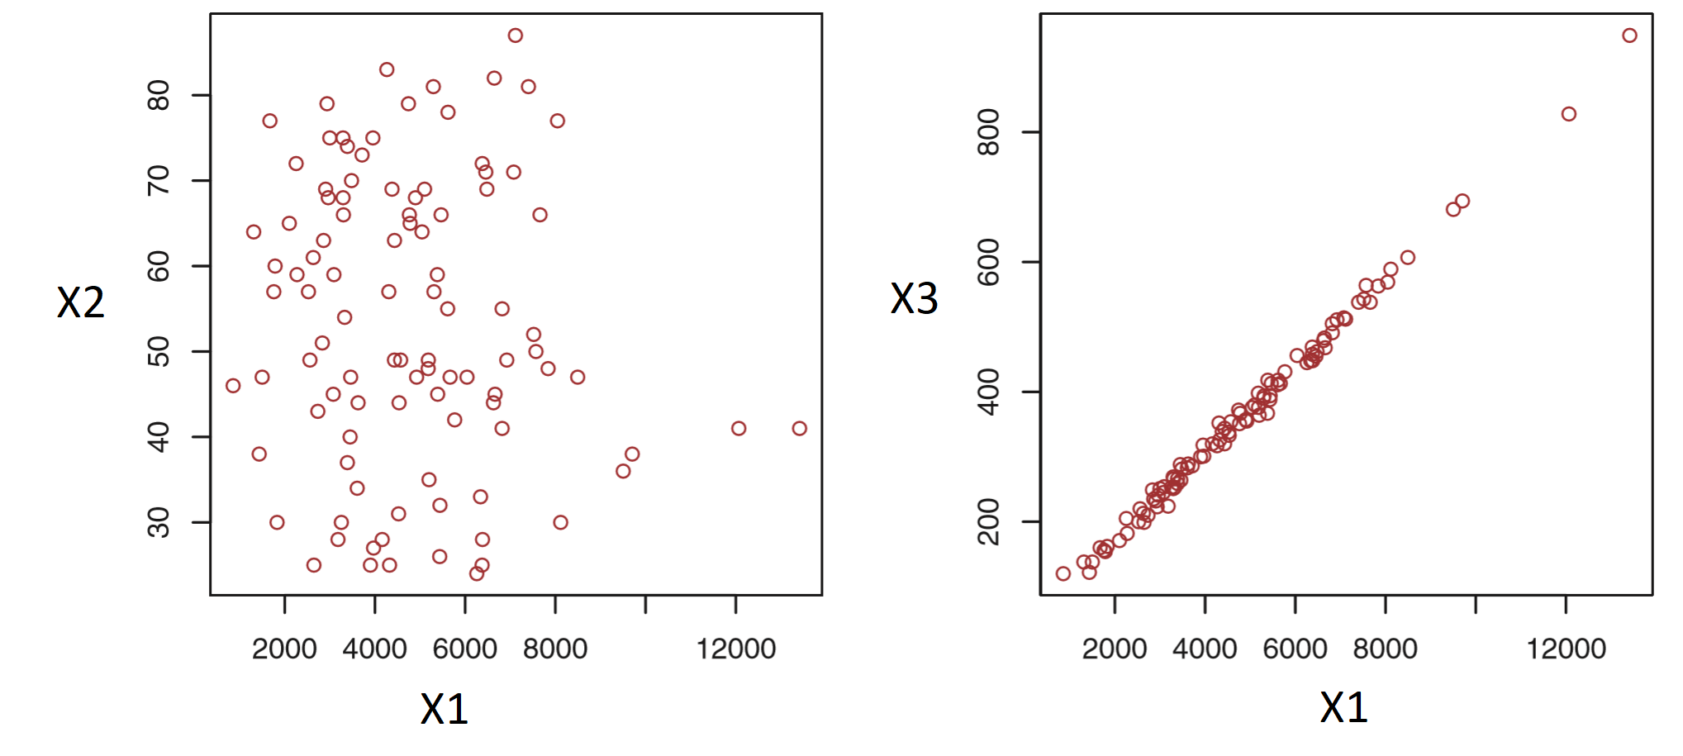
Collinearity in the Data
Collinearity means that two or more predictor values are closely related to one another.
Simple way is to calculate the correlation between the two variable
When more than two variable need to be tested, calculate the variance inflation factor (VIF)

Slide 12
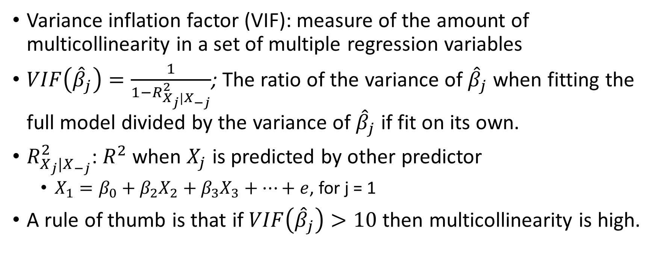
Variance Inflation Factor
Variance inflation factor (VIF): measure of the amount of multicollinearity in a set of multiple regression variables
$VIF\left({\hat{β}}_{j}\right)=\frac{1}{1−R_{X_{j}|X_{−j}}^{2}}$; The ratio of the variance of ${\hat{β}}_{j}$ when fitting the full model divided by the variance of ${\hat{β}}_{j}$ if fit on its own.
$R_{X_{j}|X_{−j}}^{2}$: $R^{2}$ when $X_{j}$ is predicted by other predictor
$X_{1}=β_{0}+β_{2}X_{2}+β_{3}X_{3}+…+e$, for j = 1
A rule of thumb is that if $VIF\left({\hat{β}}_{j}\right)>10$ then multicollinearity is high.
Notes:
There isn’t a distinct threshold for determining if the VIF of beta is multicollinearity. Generally use 10 but sometimes 5 is also commonly used
R Squared: https://en.wikipedia.org/wiki/Variance_inflation_factor
A:

Slide 13
The Marketing Plan
Using Advertising data

Slide 14
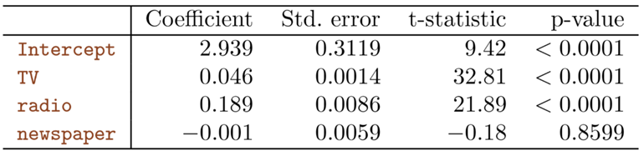
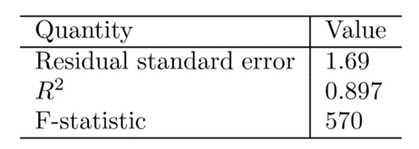
Is there a relationship between advertising sales and budgets?
Answer by fitting the data:
← F-statistic greatly exceed 1

Slide 15


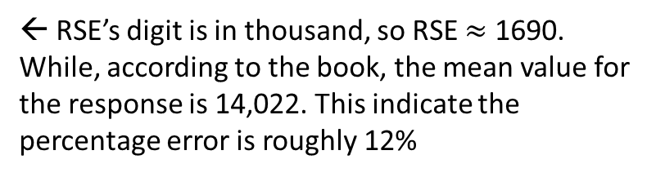
How strong is the relationship?
Residual Sum of Squares (RSE) and $R^{2}$
The $R^{2}$ shows that almost 90% of the variance in sales is explained by the predictors
← RSE’s digit is in thousand, so RSE $≈$ 1690. While, according to the book, the mean value for the response is 14,022. This indicate the percentage error is roughly 12%

Slide 16
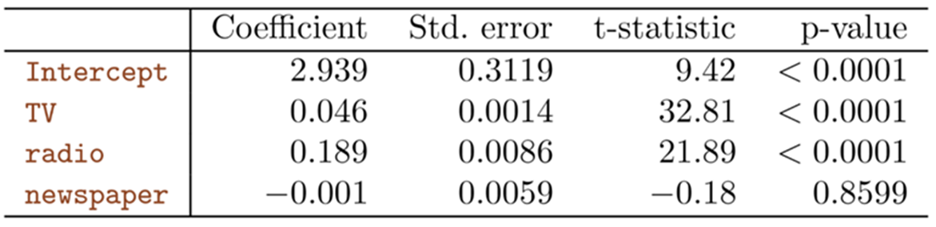
Which media contribute to sales?
Examine the p-values associated to each predictor’s t-statistic
The table above shows that the p-values associated with TV and radio are low, but the p-value for newspaper is not.
This suggest that only TV and radio are related to sales

Slide 17
How large is the effect of each medium in sales?
Confidence Interval: TV and Radio’s confidence interval is narrow and far from zero. While newspaper revolve around zero.
The interval include 0 for newspaper indicated that the variable is not statistically significant given the values of TV and radio
Advertising Medium | 95% Confidence Interval
TV | (0.043,0.049)
Radio | (0.172, 0.206)
Newspaper | (-0.013, 0.011)

Slide 18
Is the relationship linear?
Residual plot between fitted value and residual.
If the relationship is completely linear, no noise, there should be no residual point in the residual plot.
If the residual centered closely around the 0 residual line, then this means that there is a linear relationship between budgets and sales
Residual Histogram
If the number of frequency for 0 residual is the most and other frequency form the histogram like a bell shape, then we can conclude that there is a linear relationship, with normal distribution of mean 0

